Slide 1



Smart Bussiness Analytics Dashboard
Integrating Python Machine Learning Pipeline with Power BI Visualizations for Advanced Forward-Looking Enterprise Demand Insights
Bhanu Prakash
Prabhuling
Pavan Teja
Vasari Poojan
2420030365
2420030396
2420030497
2420030436

Slide 2


Problem Statement & Legacy Gaps
Problem Statement
Identified Legacy Gaps
Enterprise e-commerce organizations struggle to make timely, forward-looking operational decisions due to reliance on legacy Business Intelligence (BI) dashboards.
Static Focus: Strict historical tracking with zero native capability for time-series forecasting or non-linear demand modeling.
Data Latency: Manual CSV spreadsheet operations introduce human error, reporting bottlenecks, and stale inventory views.
These legacy systems operate primarily on static, backward-looking descriptive metrics, leaving businesses unable to accurately anticipate demand shifts, stockouts, or customer churn.
Cost & Performance: Cloud ML add-ons carry heavy per-user licensing fees, while client-side calculations cause lag.

Slide 3









Key Project Objectives
Automated Integration
Predictive ML Engine
Real-Time Governance
Build an automated multi-source ETL pipeline using Python (Pandas, SQLAlchemy) and PostgreSQL Star Schema to eliminate manual CSV handling and lower query latency under 2.0s.
Embed open-source Machine Learning models—Meta Prophet for demand forecasting and XGBoost/Random Forest for churn scoring—improving demand precision by over 20%.
Construct dynamic Power BI dashboards with automated alert triggers for stock drops, integrated Row-Level Security (RLS), and end-to-end TLS encryption with $0 extra software cost.

Slide 4

Empirical Literature Benchmarking
Author & Year | Methodology / Focus | Key Empirical Findings | Identified Gaps Refined
Chen et al. (2021) | Python ML + Legacy BI Frameworks | Forecast accuracy increased by +24% over static BI | High computational latency in client-side recalculations
Kumar & Verma (2022) | Power BI vs. Tableau Streaming | Power BI demonstrated superior DAX execution speed | Lacked built-in custom ML modeling engines
Ahmad & Zhang (2023) | Automated Sentiment Pipelines | Real-time tagging accelerated customer churn response | Scalability constraints on unindexed local data
Patel et al. (2024) | Serverless Python APIs + Cloud Datasets | Reduced dashboard render latency by 40% | Complex multi-cloud deployment orchestration

Slide 5


Solution Architecture & Hybrid Pipeline
1. Automated Multi-Source ETL
2. Preprocessing & Feature Scaling
Python connectors ingest transactional logs, order queues, and CRM profiles via Pandas & SQLAlchemy directly from raw storage.
Automated outlier detection, missing value imputations, and feature engineering for promotional indicators and seasonal spikes.
3. Star Schema Data Warehouse
4. Power BI Direct Integration
Cleaned datasets loaded into PostgreSQL, optimizing Fact Orders and Dimension tables for sub-second DAX execution.
Power Query consumes structured warehouse tables to render real-time KPIs, dynamic drill-downs, and automated visual updates.

Slide 6









Predictive ML Engine Modules
Meta Prophet Model
XGBoost Regressor
Random Forest Churn
Captures complex non-linear weekly and annual seasonality, holiday surges, and promotional discount spikes with high temporal accuracy.
Models multi-variable feature dependencies including price elasticity, customer acquisition cost (CAC), and channel ad-spend efficiency.
Calculates individual customer churn probability scores based on purchase frequency, recency, and average order value (AOV) drops.

Slide 7


Real-Time Operational Intelligence
Automated Background Inspection: Python scripts continually inspect live inventory logs and flag anomalous order drop-offs.
Proactive Alert System: Instant alert triggers highlight potential stockouts and expenditure spikes directly inside the dashboard.
Automated CRM Retention: High-risk churn profiles are pushed directly to targeted campaigns before customer attrition occurs.
Reduced Response Latency: Replaces weekly manual reviews with immediate operational responsiveness.

Slide 8

Key Performance Benchmarks
+24%
100%
<2.0s
85%
Forecast Precision
ETL Automation
Query Latency
Churn Precision
Improvement vs legacy BI
Zero manual CSV handling
Optimized Star Schema DAX
Targeted at-risk segment identification

Slide 9
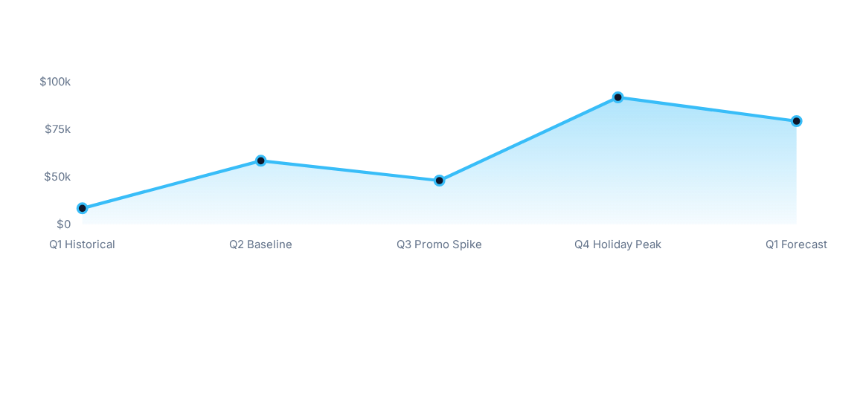
12-Month Demand & Revenue Forecast

Slide 10

Governance & Operational Feasibility
$0 Additional Software Cost
Security & Enterprise Governance
Open-Source Core: Leverages existing Python packages (Pandas, Scikit-Learn, Prophet) for ML execution without per-user cloud AI add-on costs.
Row-Level Security (RLS): Restricts regional store managers to departmental data slices.
End-to-End Encryption: TLS encryption enforced across Python-SQL pipelines and Power BI service endpoints.
Infrastructure Reuse: Integrates directly into existing corporate Power BI Desktop and PostgreSQL instances for zero marginal expenditure.

Slide 11




12-Week Implementation Roadmap
W11–W12: Deployment
W3–W6: ETL & ML
RLS security configuration, cloud deployment & User Acceptance Testing.
Automated Python ETL engineering & Prophet/XGBoost model training.
W1–W2: Architecture
W7–W10: Power BI
Requirements gathering & Star Schema data warehouse setup.
Power BI modeling, DAX engine optimization & executive UI development.

Slide 12
Thank you

